Slide 1
Research methods: Finding your way in computer vision
Thomas Lux
Notes:
So I will speak about methodology when approaching research in the computer vision field of computer science.

Slide 2

Computer vision
Using images or sequences of images to produce some valuable information
Images consist of thousands of ‘pixels’
where each pixel contains color
information
Notes:
The driving force behind computer vision is making use of digital cameras.
Remember that all images are just thousands of numbers to a computer.
The research I am doing focuses on making computers use videos to navigate space.

Slide 3


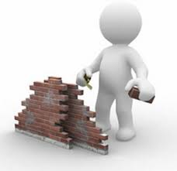
Three steps
Have an idea
Research for relevant work
Create and test the idea
Notes:
So when I stopped to think about my process, I realized that there are three main steps I follow.
Creative process, just lofty thought for fun.
Learning process, searching for what work has been put into the idea already and understanding it.
Working process, making my ideas solid by writing them in code and testing how they work.

Slide 4
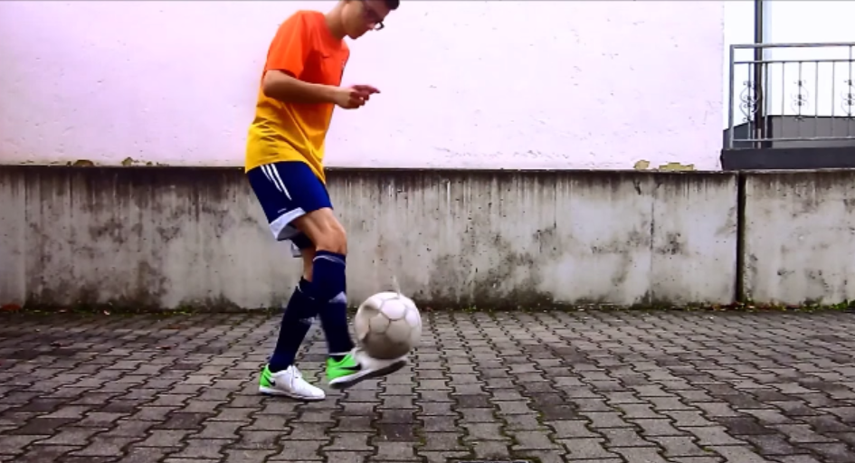

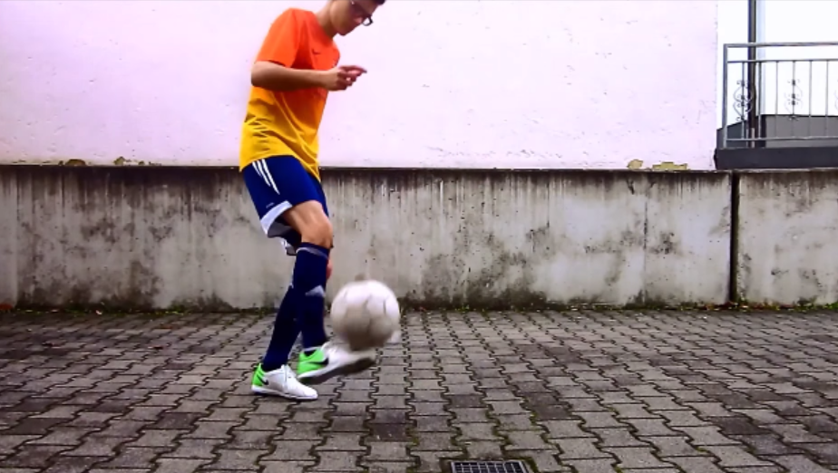
Step One: Having an idea
What can we see that is ‘valuable’ in this image set?
Image 1
Image 2
Image 3
Notes:
ball - the point of focus.
ball - moving, guy - moving.
Ball – our name, so it is an object
Guy – patch of orange
Background – patch of grey

Slide 5
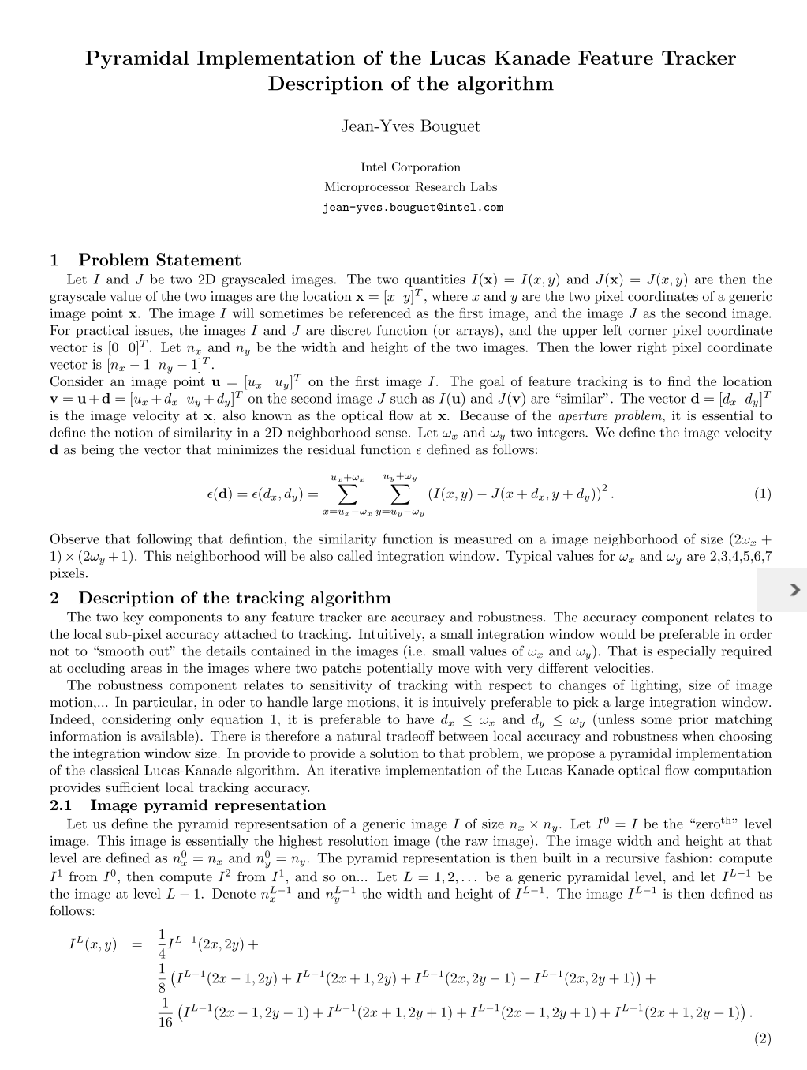
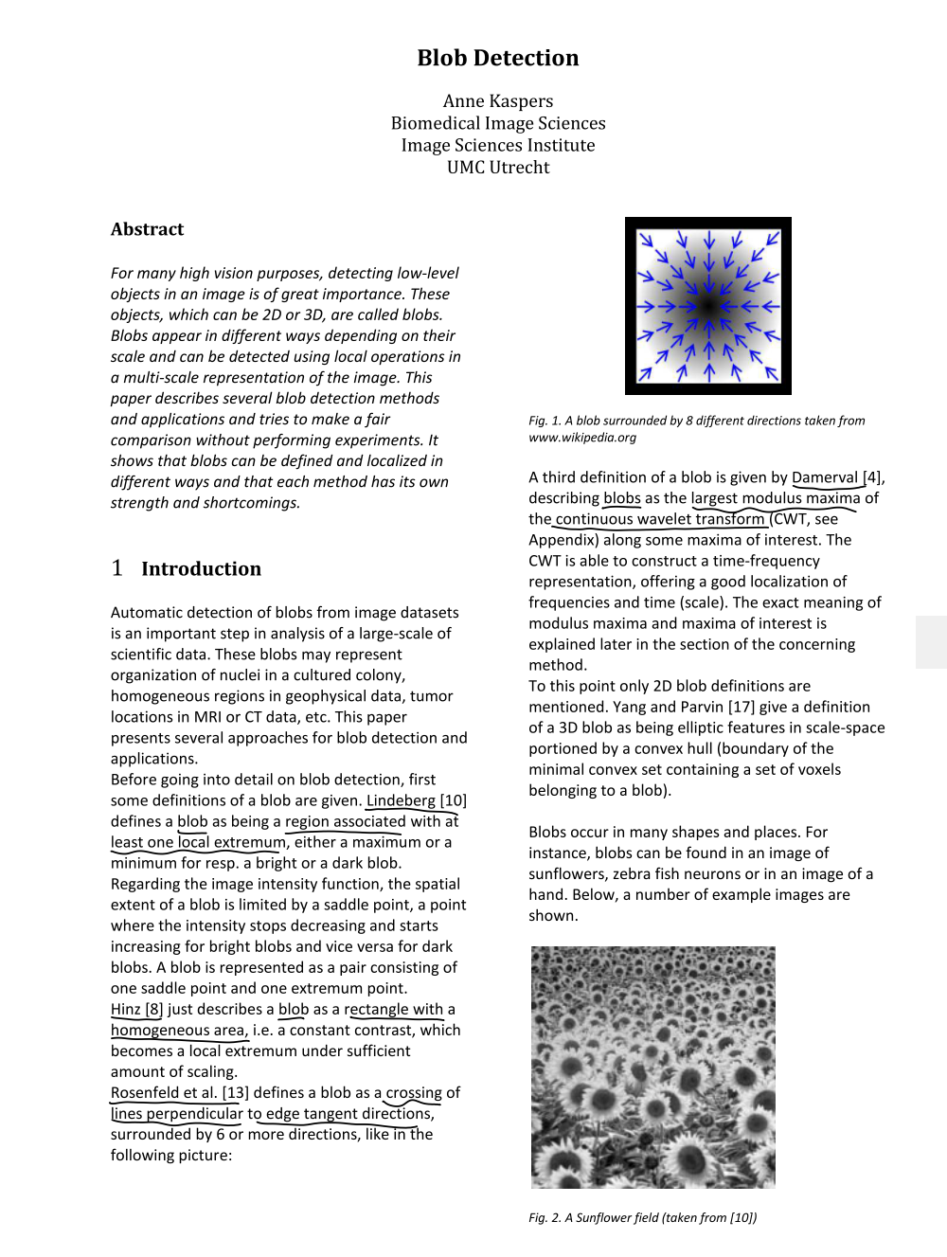
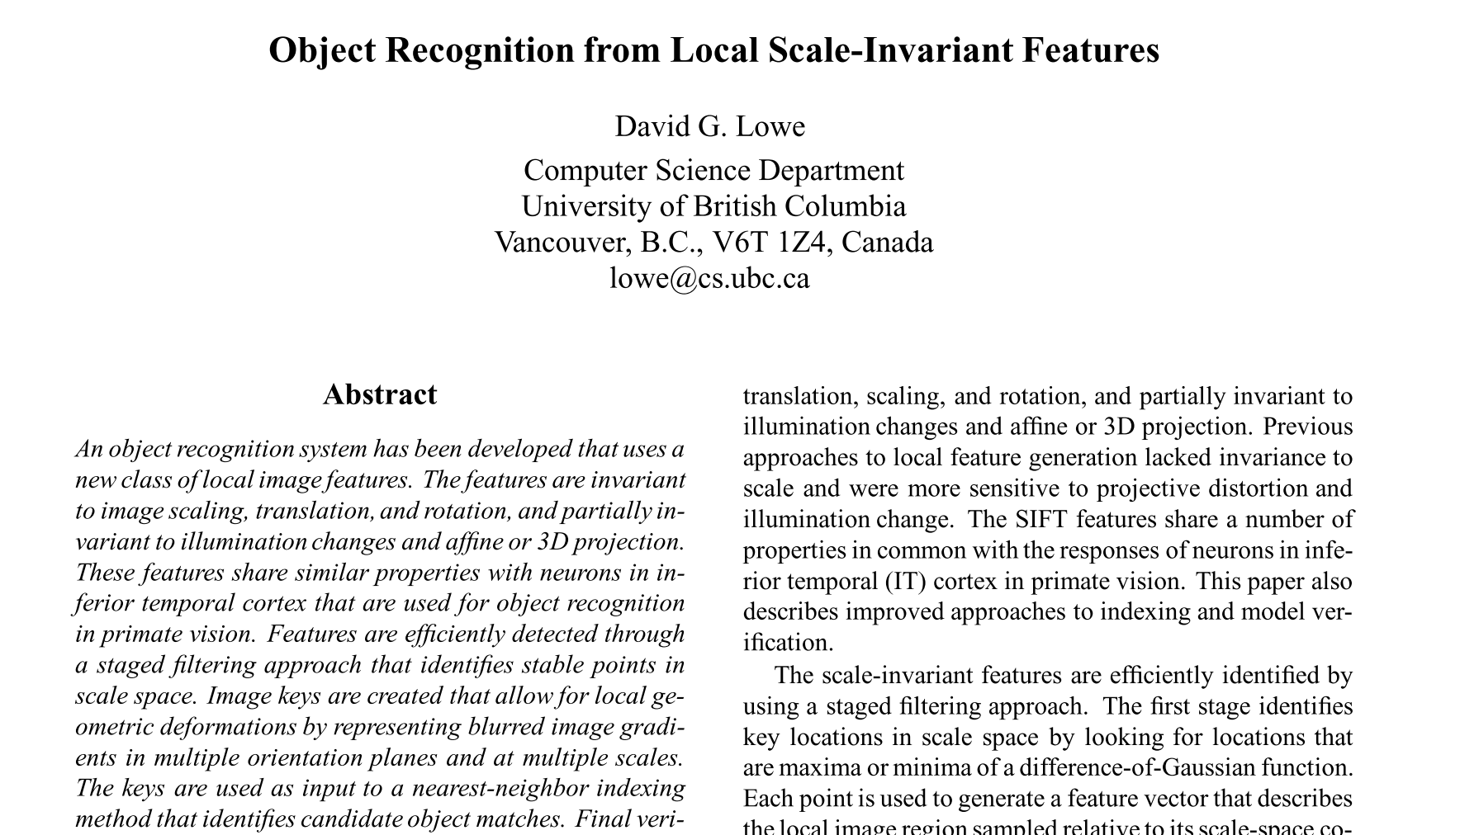
Step Two: Researching for relevant work
What words describe our idea?
Notes:
So there’s a ball, there’s a person, there’s movement.
Ball – Object
Ball – Blob
Movement – Tracking

Slide 6
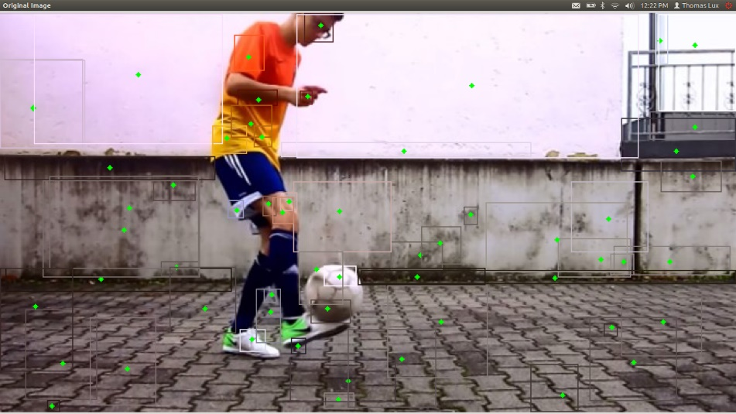
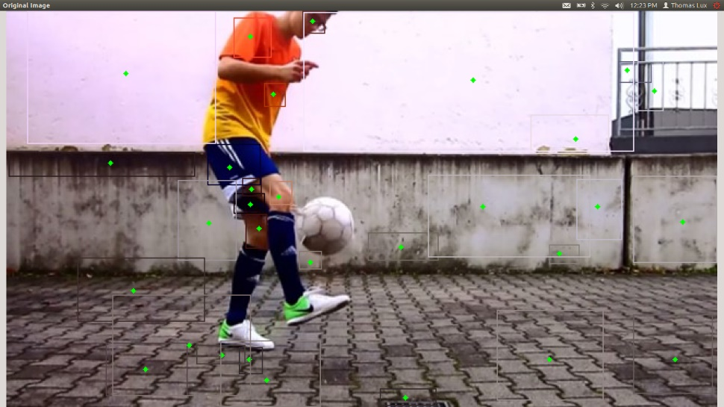
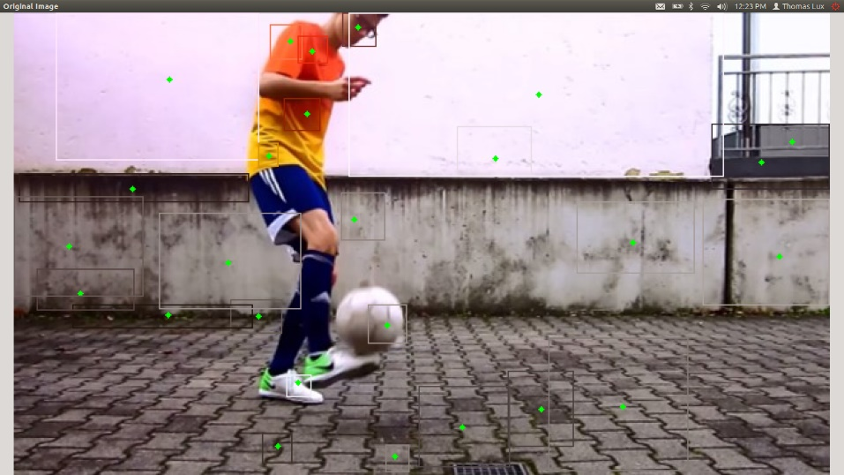
Step Three: Creating and testing our idea
We turn our idea into words a computer understands and then run different images through it to see if it actually produces the ‘valuable’ information we originally wanted!
Notes:
This is actually the results of the work I’ve done so far. The green dots are the center of “blobs” in the image, they can be tracked between these three frames to detect motion

Slide 7
Research methods: Computer Vision
There are many more obstacles to be faced on the way, but those are the details that we all deal with in our own fields.
Step One: Have an idea
Step Two: Research relevant work
Step Three: Create and test the idea

